Slide 1

Rockbuster Co.
Business Analysis

Slide 2
Objective
To demonstrate which movie genre and customer geographic location contributed the most/least to revenue gain. Further, to demonstrate which countries have highest fidelity in products.

Slide 3
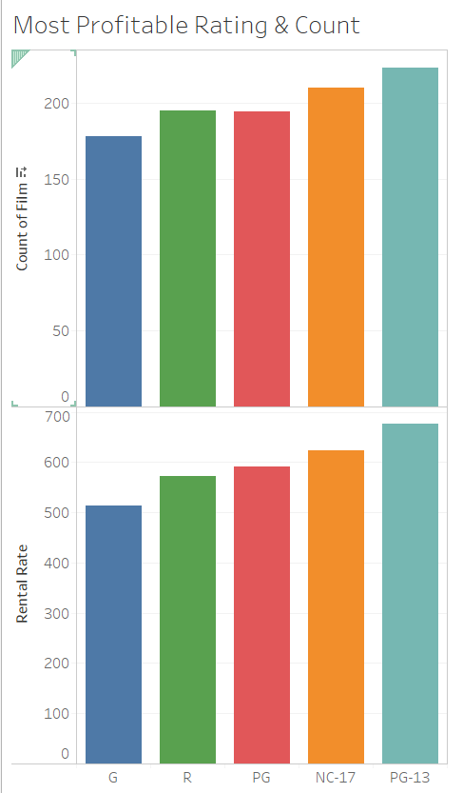
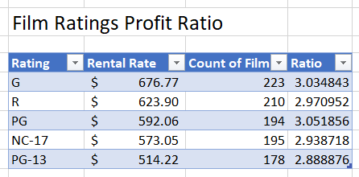
Interestingly, the rating with highest profit per count ratio are PG rated movies.

Slide 4
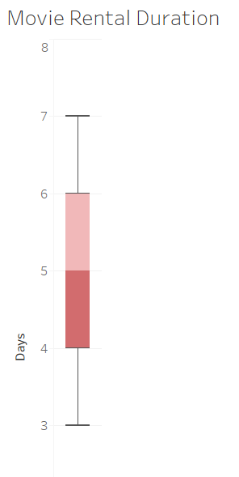
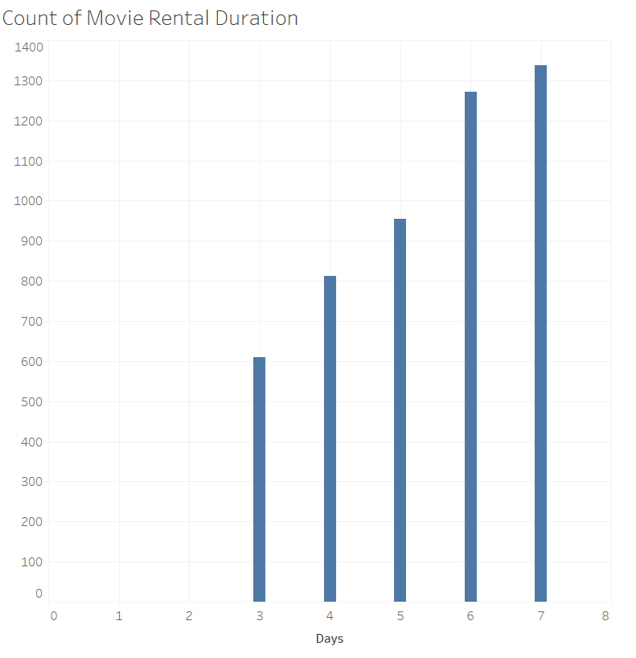
Statistics:
The average rental duration is 5 days
Minimum rental duration is 3 days
Maximum rental duration is 7 days
The most common duration of rental is 7 days.

Slide 5
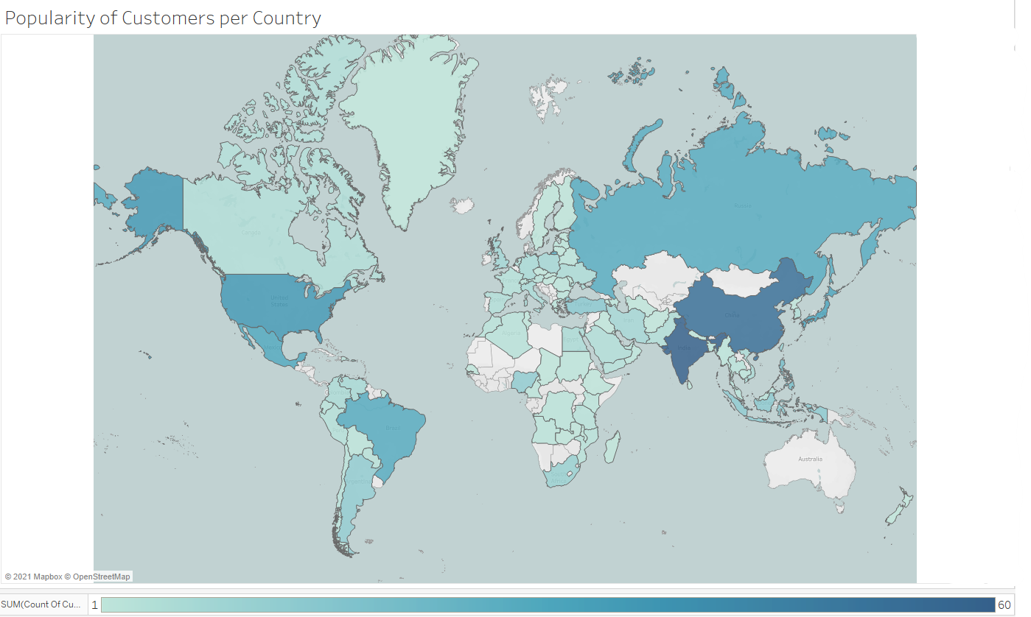
Most Popular Countries:
India (60 customers)
China (53 customers)
United States (36 customers).

Slide 6
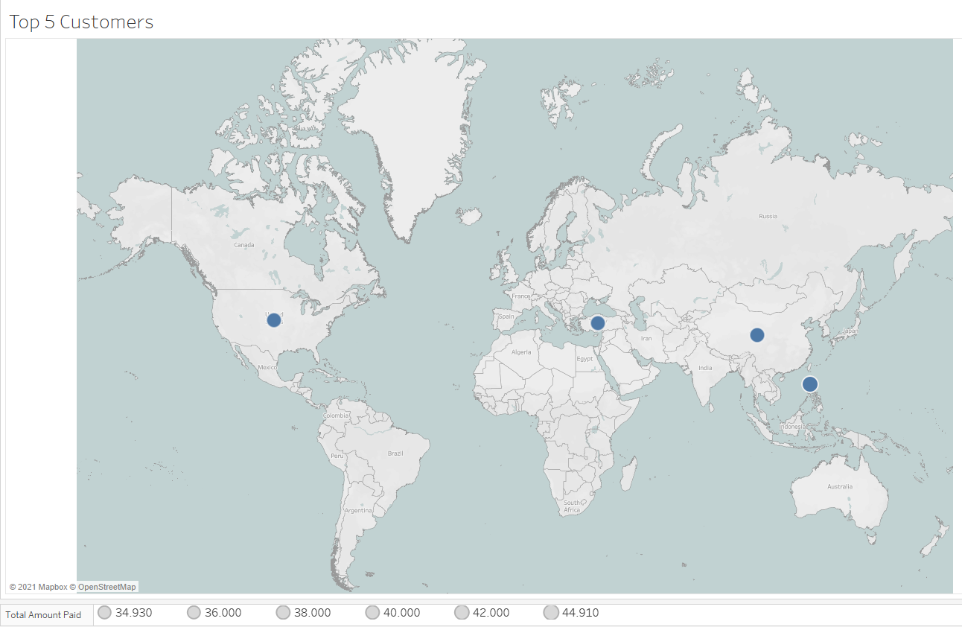
Customers and Countries with Highest Loyalty:
Theresa from Philippines ($45)
Clinton from US ($40)
Casey from Turkey ($40)
Alan from China ($40)
Phyllis from China ($35)

Slide 7
Recommendations
It is in the best interest of Rockbuster to do the following in order to maximize profit:
Continue to invest in rated PG movies.
Focus capital on movies that have a longer rental duration.
Continue to invest in top rated markets as India, China and USA.
Center product loyalty on Philippines, USA, Turkey and China.

